Slide 1

TEK306: Sikkerhet i mobile applikasjoner
Cross-platform Mobile Apps & Security

Slide 2
Content
Platform fragmentation
Cross-platform development
Security in cross-platform Apps
Security in Cordova
Scripting attacks
Security controls

Slide 3
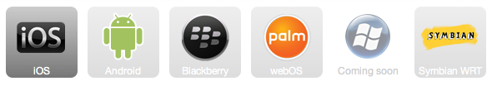
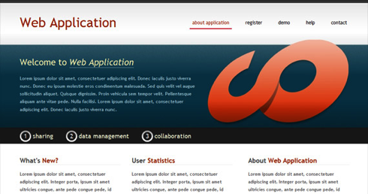

Platform fragmentation
Windows 7
Multiple Teams/Products
Source: synerzip.com

Slide 4
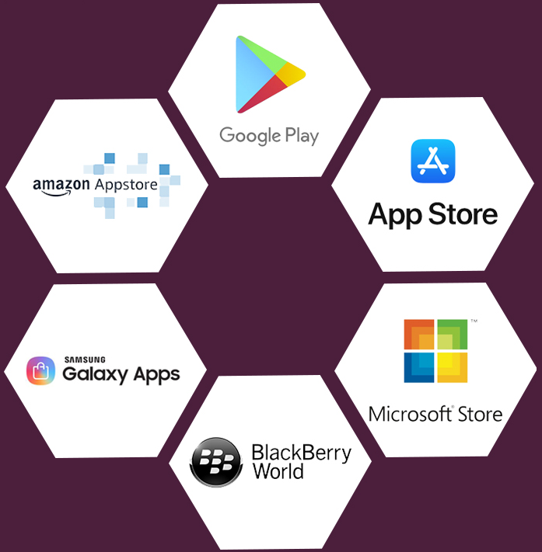
Platform fragmentation …
What are the technologies used to implement each of types of mobile apps?
In what circumstances can one choose to use each type of mobile app?
What are the advantages/disadvantages of each type of mobile app?
Notes:
Samsung Galaxy Store is an app store used for devices manufactured by Samsung Electronics that was launched in September 2009. The service is primarily supplied pre-installed on Samsung Galaxy smartphones, Samsung Gear, and feature phones.
Amazon Appstore is an app store for Android-compatible platforms operated by Amazon.com Services, LLC, a subsidiary of Amazon. The store is primarily used as the storefront for Amazon's Android-based Fire OS. including Amazon Fire tablets, and Amazon Fire TV digital media players.
BlackBerry World is an application distribution service, aka an 'app store', and application by BlackBerry Limited; for BlackBerry 10 devices, the BlackBerry PlayBook, and a majority of BlackBerry OS devices.

Slide 5
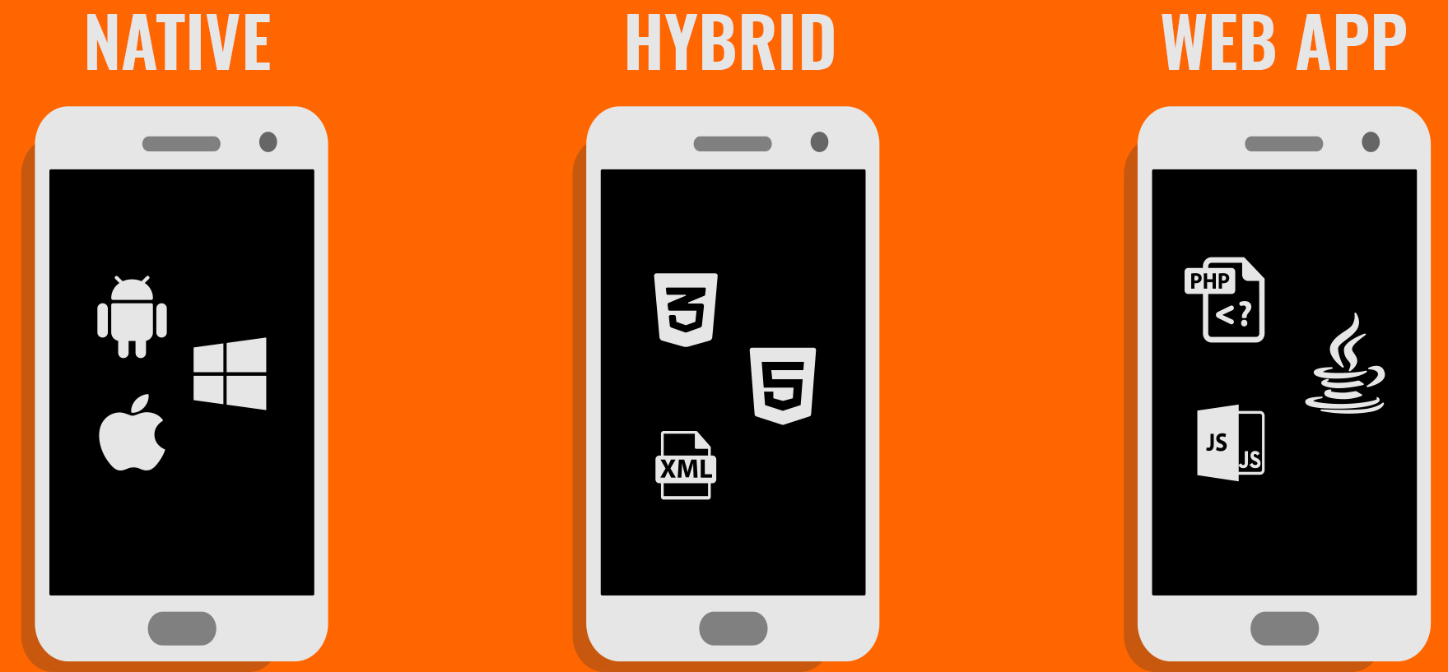
Platform fragmentation …

Slide 6
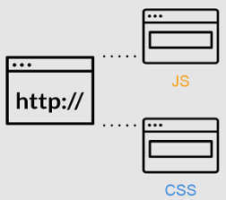
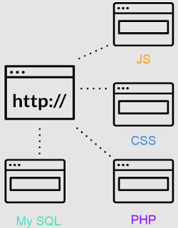
Platform fragmentation …
Web Apps
Mobile Web App → mobile friendly Web
Web App vs Website (vs Web page)
Web App: every user see different information each time.
Further reading: https://dinarys.com/blog/website-vs.-webapplication
Notes:
Uncontrolled browser backend
UI
Device hardware accessibility
etc

Slide 7
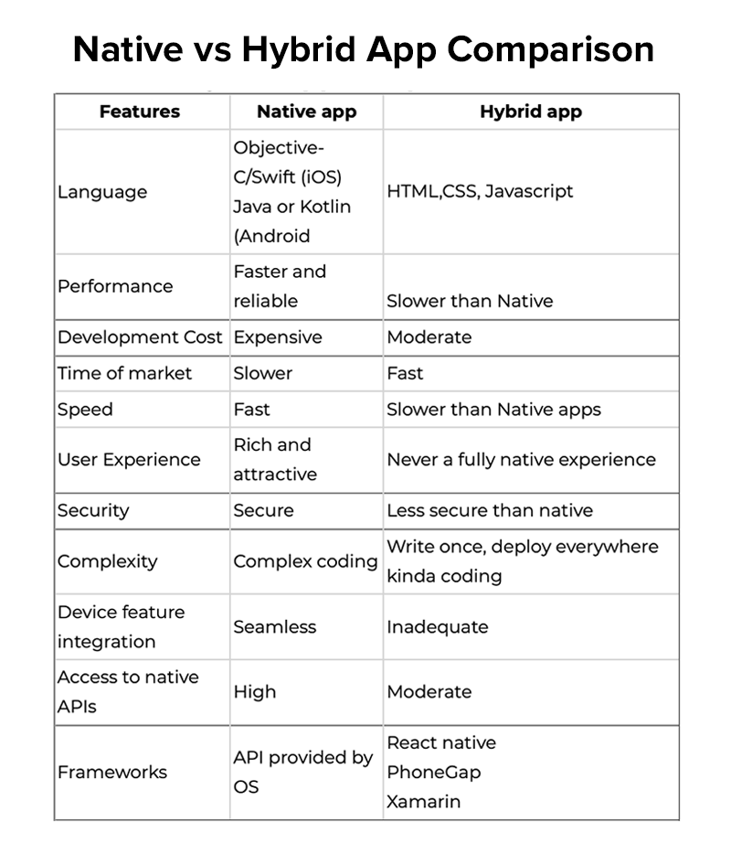
Platform fragmentation …
Further readings on types of mobile apps:
  https://appinventiv.com/blog/native-vs-hybrid-app-development/
  https://www.mobiloud.com/blog/native-web-or-hybrid-apps#4
  https://steelkiwi.com/blog/how-choose-correct-platform-mobile-app-development/

Slide 8
Native Apps →
Platform fragmentation …
When to
High Performance Apps
Heavy on OS and Device Features
Complex Network comm.
Canvas based Apps
Only Few Platforms
When not to
Performance is not the main criteria
Replicates Web Apps with few device features
Standard RESTful
Widget based apps
Many platforms

Slide 9
Hybrid Apps →
Platform fragmentation …
When to
Performance is not the main criteria
Replicates Web Apps with few device features
Standard RESTful
Widget based apps
Many platforms
Time to market is critical
Saving cost is critical
When not to
High performance Apps
Heavy on OS and device features
Complex Network comm.
Canvas based Apps
Only few platforms

Slide 10
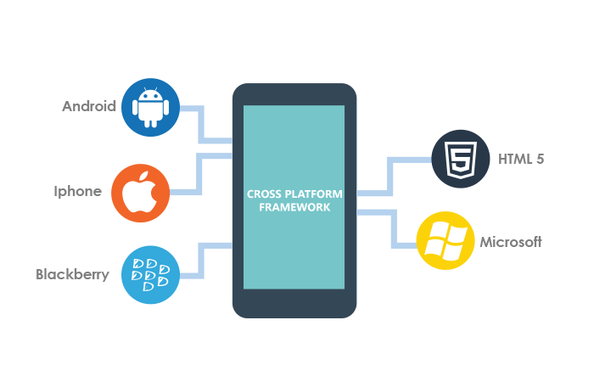
Cross-platform development
Web development for common UI.
Native code for heavy weight programming.
Use frameworks like Cordova plugin development framework to glue the two.
Use automation to regress every layer.
Notes:
Regress→ return to a former or less developed state.

Slide 11
Cross-platform development …
Coding example in Cordova
We extend DroidGap instead of an Activity.
Internally, DroidGap uses WebView (show HTML, JavaScript & CSS like Web 2.0).
WebView has hooks to call Java from JavaScript and Vice a Versa.
WebView makes a call to JavaScript to allow access to native mobile-resources (e.g., GPS, Database, File, etc.)

Slide 12
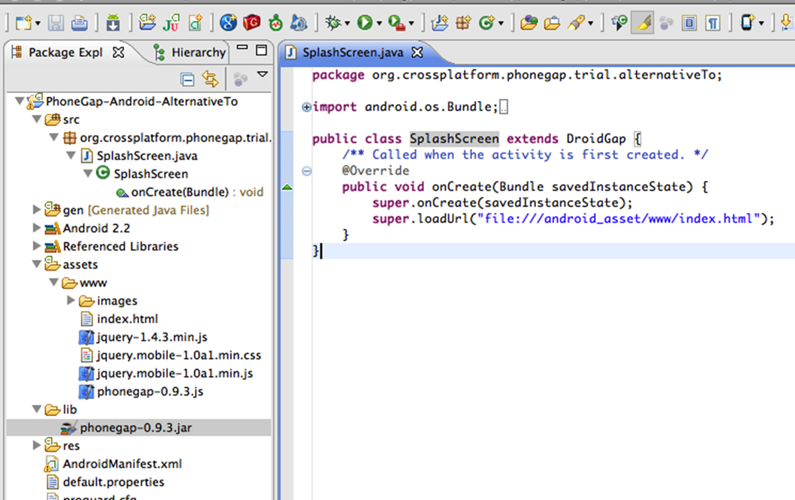
Cross-platform development …
Coding example in Cordova …

Slide 13
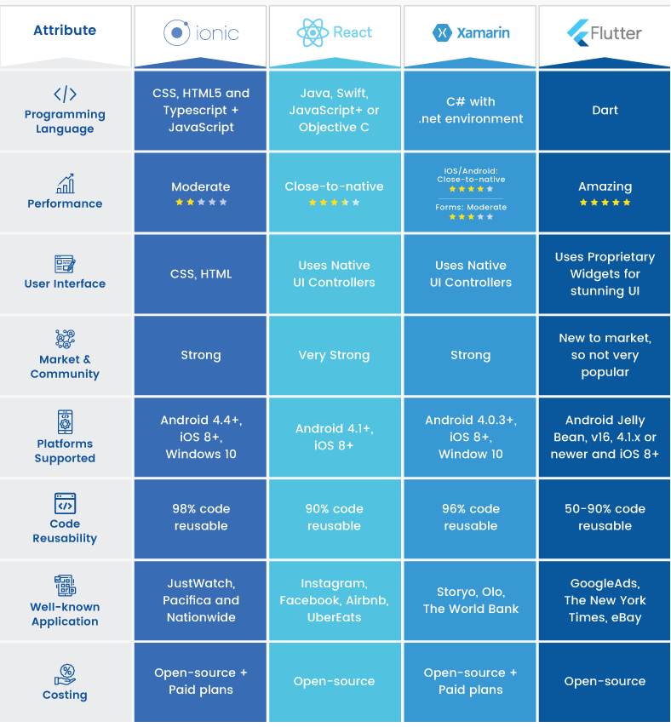
Cross-platform development …
Comparisons of frameworks
Notes:
When building for mobile devices you can take one of three approaches: Web apps, Hybrid Apps or Native apps.
Titanium is an attempt to achieve code reuse with a unified JavaScript API, with platform-specific features and native performance to meet user expectations. When you write a Titanium application, you are writing a native application in JavaScript. Titanium is a framework for writing native apps, versus an abstraction from the actual platform you are targeting. Example titalium code for Android https://gist.github.com/marshall/839017/58f6469e273f55c01e7075049aba9c36d21cbf0d
Web Apps are websites designed to fit in mobile screens and are accessed by typing a URL in the phone’s browser. There are multiple UI frameworks that can make your Web app look like a native app, or you can build it using media queries to make it responsive to the web browser’s dimensions.
Hybrid Apps are Web apps that are packaged in a custom full-screen browser to resemble a native mobile app, with extensions that provide access to some hardware features, but your user interface is still written in HTML/CSS and rendered by a web browser.
Native Apps are written using different languages depending on the platform. Native apps have full access to the hardware and the user interface is rendered by the platform SDK.
https://devblog.axway.com/mobile-apps/comparing-titanium-and-phonegap/

Slide 14
Cross-platform development …
What is the trend?
WebKit as being the next virtual machine, which may go beyond the limits of Java.
HTML5, CSS3 and JavaScript constitute the set of technology that lessens the fragmentation.
HTML5 will compete with native components.

Slide 15
Security in cross-platform mobile apps
SECURITY
Android App development
iOS App
development
Cross-platform App development

Slide 16
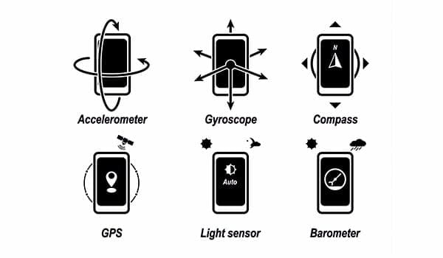
Security in Cordova
Features of Cordova API:
Accelerometer- accesses device’s motion sensor.
Camera- captures photo using the device’s camera.
Compass- obtains direction of the device pointing.
Contacts- works with the device’s contact database.
Filesystem- hooks into the device’s file system.
Geolocation- accesses the device’s GPS location.
Media- accesses (records) videos, audio or images.
Network- performs accesses or requests network.
Notifications- accesses visual device notifications.
etc
//Accessing camera using getPicture() API in Cordova
navigator.camera.getPicture(this.onPhotoDataSuccess, this.onFail, {
  quality: 50,
  destinationType: Camera.DestinationType.DATA_URL,
  sourceType: Camera.PictureSourceType.CAMERA
});
Notes:
Any vulnerability that can be exploited to execute arbitrary script may allow the attacker to invoke the APIs for malicious purposes. Here is a simple example of how you can use the PhoneGap API to take a photo using the device’s camera using the getPicture() API call (https://github.com/apache/cordova-plugin-camera/blob/master/doc/index.md):
navigator.camera.getPicture(this.onPhotoDataSuccess, this.onFail, {
quality: 50,
destinationType: Camera.DestinationType.DATA_URL,
sourceType: Camera.PictureSourceType.CAMERA
});
Accelerometer- tracks the different motion like shaking, tilting, swinging, and rotating and accordingly change the orientation of your app

Slide 17
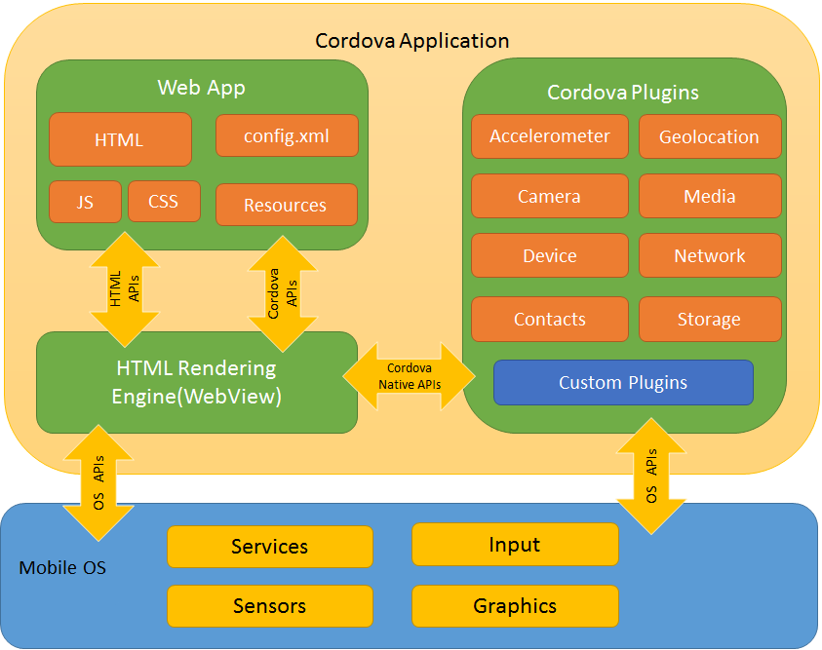
Security in Cordova …
The Cordova frameworks did not come under the scrutiny of the security community.
As the technology is a blend of native and Web, testing methods in both are applicable.
However, a number of framework-specific security considerations are available.
Cross-platform frameworks like Cordova depend on WebView (the embedded browser) availability in different platforms.
Notes:
PhoneGap is a distribution of Apache Cordova and both names can be used interchangeably.
Android WebView is a pre-installed system component from Google that allows Android apps to display web content.

Slide 18
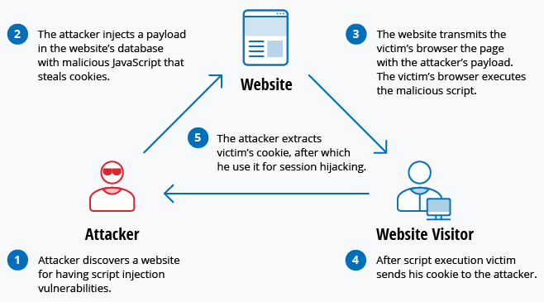
  Scripting attacks
Attacker-controlled data populated into WebView, causes cross-site scripting or cross-application attacks.

Slide 19
Scripting attacks …
Cross-site scripting (XSS)
XSS is a type of security vulnerability typically found in web apps.
It enable attackers to inject client-side scripts into web pages viewed by users.
Such vulnerability is used by attackers to bypass access controls like same-origin policy (see Cross-site scripting).
However, XSS not considered cross-application scripting …

Slide 20
  Scripting attacks …
Cross-Application Scripting (CAS)
CAS is a vulnerability affecting apps that don't check input in an exhaustive way.
It allows an attacker to insert data that modifies the behavior of apps ...
An example of CAS is when an arbitrary URL is populated into Cordova WebView when a third-party app invokes an intent.
Notes:
An example of such a vulnerability was found in Cordova on Android. This specific issue allowed an arbitrary URL to be populated into a Cordova Webview when another third party application invoked an intent. The affected code existed in the CordovaWebView class, which had a loadUrl() method similar to the following code:
public void loadUrl(String url) {
if(url.equals("about:blank") || url.startsWith("javascript:")) {
this.loadUrlNow(url);
} else{
String initUrl=this.getProperty("url",null);
if(initUrl==null){
this.loadUrlIntoView(url);
}
else{
this.loadUrlIntoView(initUrl);
}
13 }
14 }

Slide 21
Scripting attacks …
CAS attack scenarios
Tainted data from a server-side Web App (XSS) populated to the WebView.
Arbitrary URLs passed through IPC mechanisms (CAS) are loaded.
Data loaded via IPC into a WebView and dynamically populated into a JavaScript block (CAS).
See link on how to fix CAS vulnerability

Slide 22
Security controls
Domain whitelisting
Domain whitelisting is a security control in Cordova.
It defines external domains that are from outside of the app’s control- explicitly allowing to get access, privilege, service, mobility or recognition.
Whitelisted domains have access to the Cordova JavaScript objects and corresponding Cordova bridge.
It can be configured using the app’s config.xml file as:
<access origin="https://mobileapphacker.com" />.
Example of insecure whitelist- allowing unrestricted access to any domai:
<access origin="*"/>.
Notes:
Example of insecure whitelist, which allows unrestricted access to any domain, would be: <access origin="*" />.
You should be aware that this is also the default configuration for a Cordova-based application.
Domain whitelisting is an important security control when defining the resources that an application can access.
As you may recall from earlier chapters, due to the same origin policy any content loaded using the file://
protocol handler will have access to the filesystem. Therefore, any malicious third-party application that is able
to exploit an XAS vulnerability and cause a URL from a shared resource on the local filesystem (e.g., /sdcard/)
to be loaded, may be able to exploit the XAS issue to bypass sandbox restrictions and access content in the
Cordova-based application’s sandbox.

Slide 23
Security controls …
Iframes/Callbacks
If a whitelisted domain loads content via an iframe the loaded content also has access to the Cordova bridge.
Example of whitelisting an advertising network- ads loaded by iframe may accidentally expose Cordova bridge to any third-party sites.
This means a malicious ad could do any action that the app itself could perform.
There is one exception to this that when Cordova is used on iOS, all URLs are intercepted.
Notes:
An IFrame (Inline Frame) is an HTML document embedded inside another HTML document on a website.

Slide 24
Security controls …
Iframes/Callbacks …

Slide 25
Security controls …
Encrypted Storage
Cordova’s file system APIs do not support encryption.
Instead, it relies on the default behaviour of the platform.
Cordova apps running on the iOS platform have inherit default protection.
However, encryption is not supported by default in other platforms- content may be stored in plaintext.
Among the solutions to this could be using platform-specific methods like Android keystore or iOS keychain.

Slide 26
Security controls …
Security in other frameworks
React native provides secure storage, authentication, etc.
Xamarin’s security:
  Transport Layer Security (TLS) for- Android and iOS
  Local Security Measures in Xamarin.Forms
  Blocking COPY/PASTE feature from editable fields, blocking screen capture, etc.

Slide 27
Class activities:
Individual participation 1: Discussion questions via Mentimeter (Week45)
Individual participation 2: Questions via Kahoot (Week45)
Group activity: List of activities to be provided
Work on “Obligatory assignment 2“
NB: Additional information about the activities yet to be provided in separate document.

Slide 28
Next topic
Course summary, wrap-up

